Slide 1
Detecting optimal investment opportunities in sports retail using unsupervised learning

Slide 2
Investing in Sports Retail
The current social distancing measures worldwide have maybe urged a wider audience to actively engage with sports individually
Massive interest in participating in group sports again once life returns to normal
A successful investment in sports retail takes under consideration a location’s demographics, socioeconomic factors and exposure to fitness enthusiasts

Slide 3
Data Sourcing and Pre-processing
Total number of sports venues: Foursquare developer services
NYC neighborhood Median Salary: https://ny.curbed.com/2017/8/4/16099252/new-york-neighborhood-affordability
Total population for each neighborhood: https://data.cityofnewyork.us/City-Government/New-York-City-Population-By-Neighborhood-Tabulatio/swpk-hqdp
The data were individually collected from the various sources, then joined together and standardised to be used for model development

Slide 4
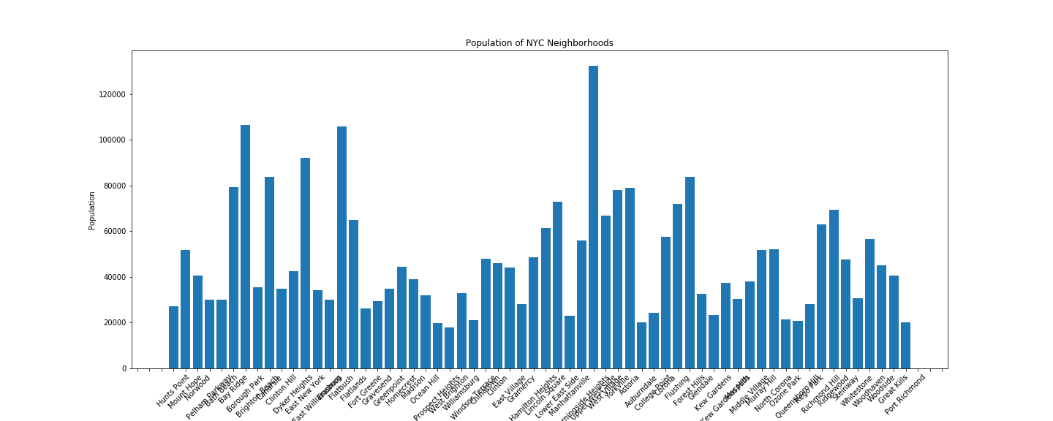
Exploratory Data Analysis
Identifying most populated neighbourhoods

Slide 5
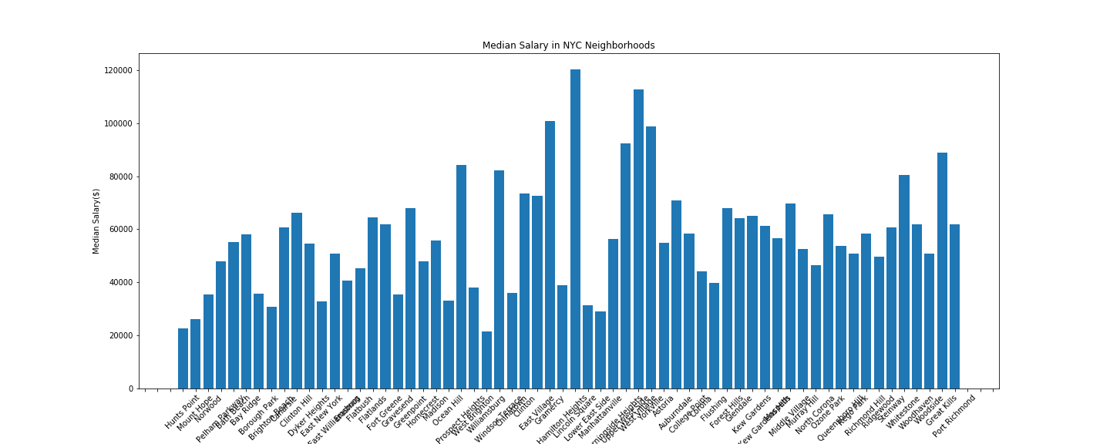
Exploratory Data Analysis
Identifying wealthy neighbourhoods

Slide 6
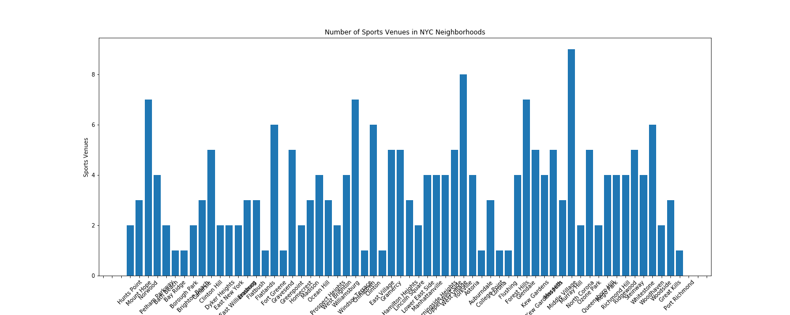
Exploratory Data Analysis
Identifying neighbourhoods with most existing sports venues and facilities

Slide 7
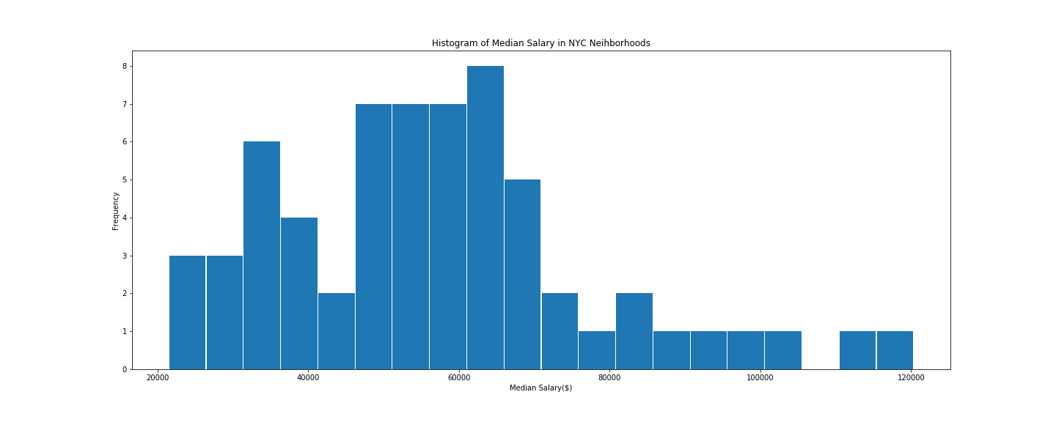
Exploratory Data Analysis
Median salary distribution is skewed to the right

Slide 8
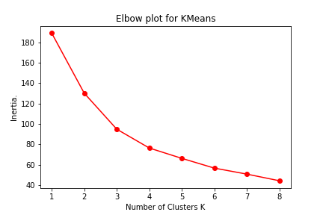
K Means Clustering
Apply K Means clustering to standardised matrix of features
Optimal number of clusters: K = 3

Slide 9
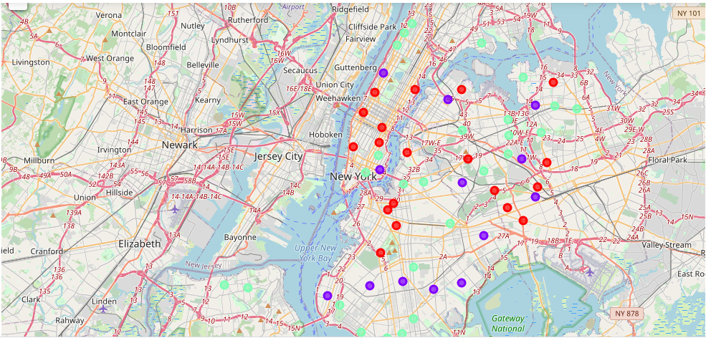
K Means Clustering
NYC neighbourhoods segmented according to population, median salary and number of sports venues

Slide 10
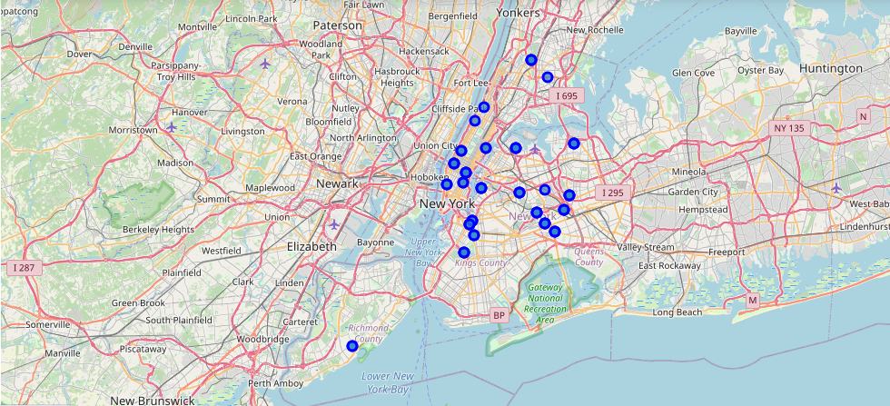
K Means Clustering
Neighbourhoods corresponding to cluster with highest average population, median salary and number of sports venues

Slide 11
Conclusion and Future Developments
A retail store will have higher chances of being successful in an area with high exposure to a wealthy audience, with plenty of places to exercise and put the sports equipment into use.
Further analysis could include further data collection such as historical data on the outcome of investment in sports retail
Classification techniques could be used to classify new hypothetical investments based on neighborhood attributes

